Slide 1
Hemodinamik qeyri-stabil pasientə yanaşma
Dr. Türkan Nəbiyeva

Slide 2

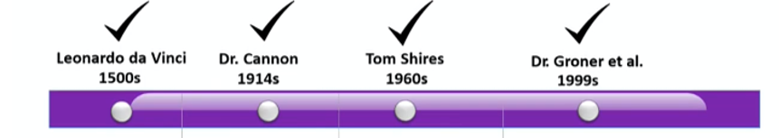
Stable = No worse than before
Patient can be stable but still critically ill

Slide 3
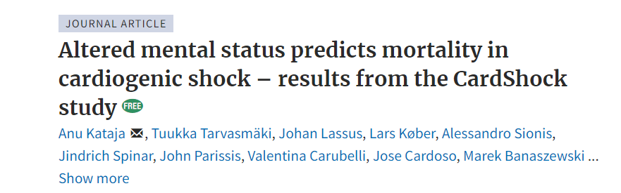
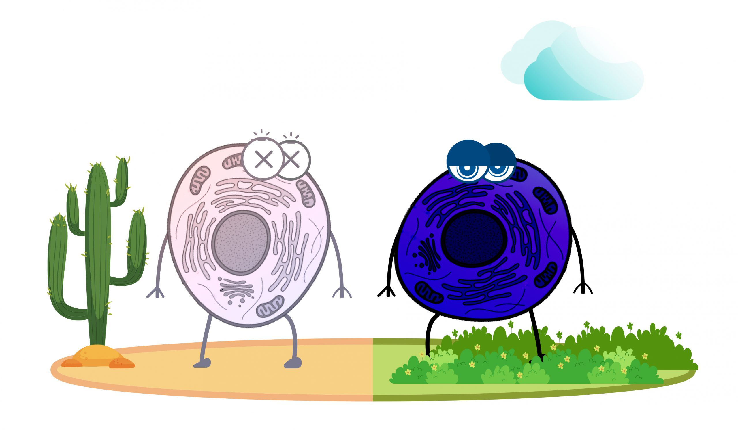
Neurological symptoms are detected in up to 70% of

Slide 4
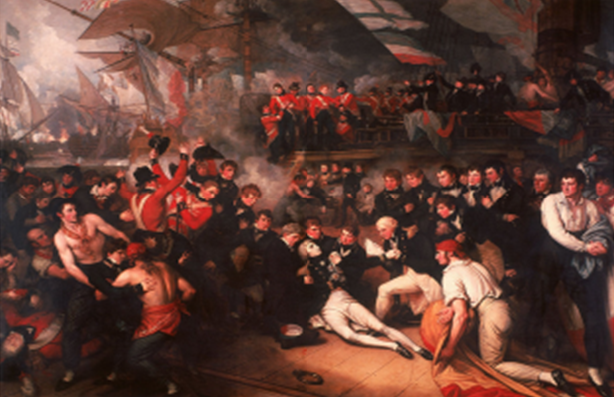
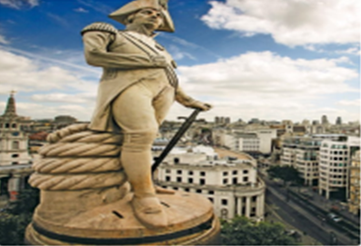
Death of General Nelson in 1805
Kısmet, Hardy

Slide 5
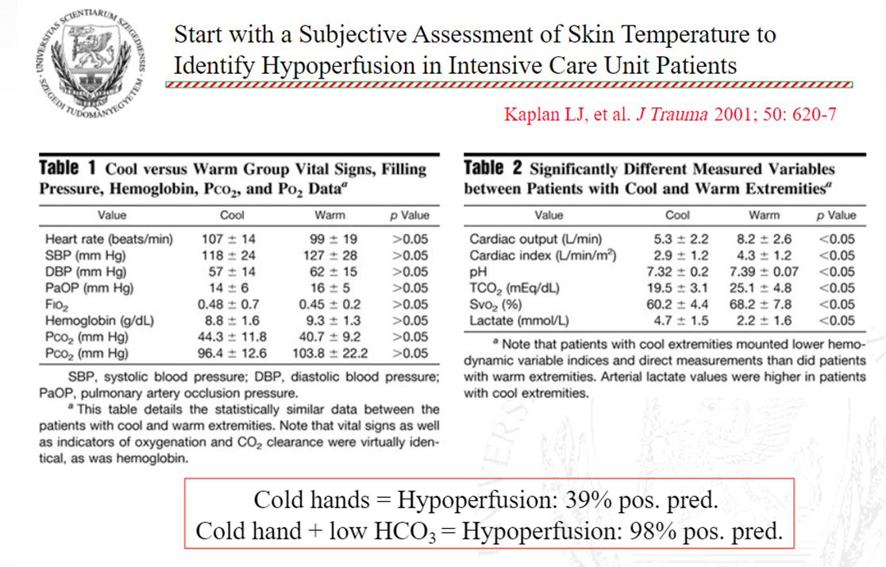
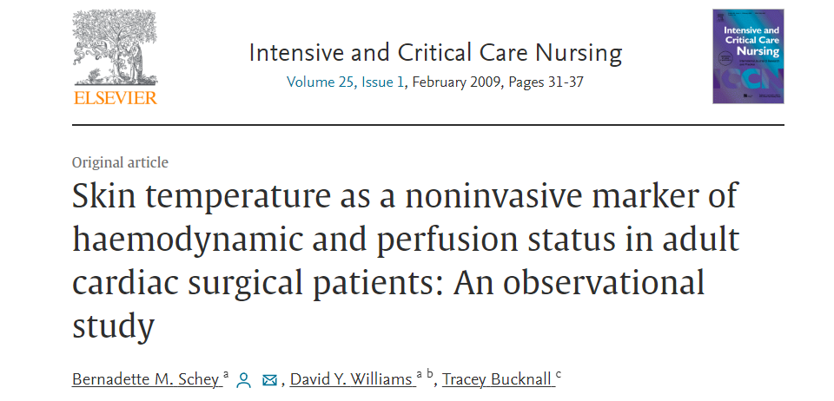

Slide 6
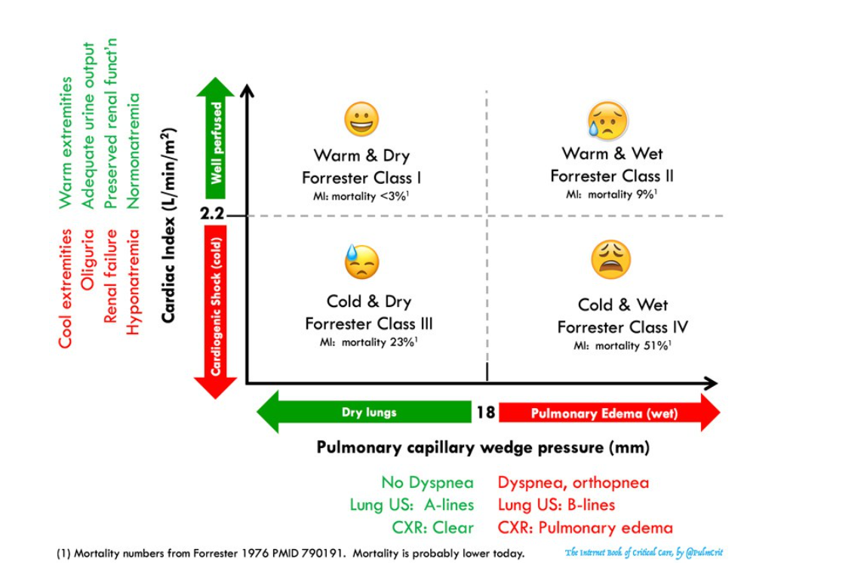

Slide 7
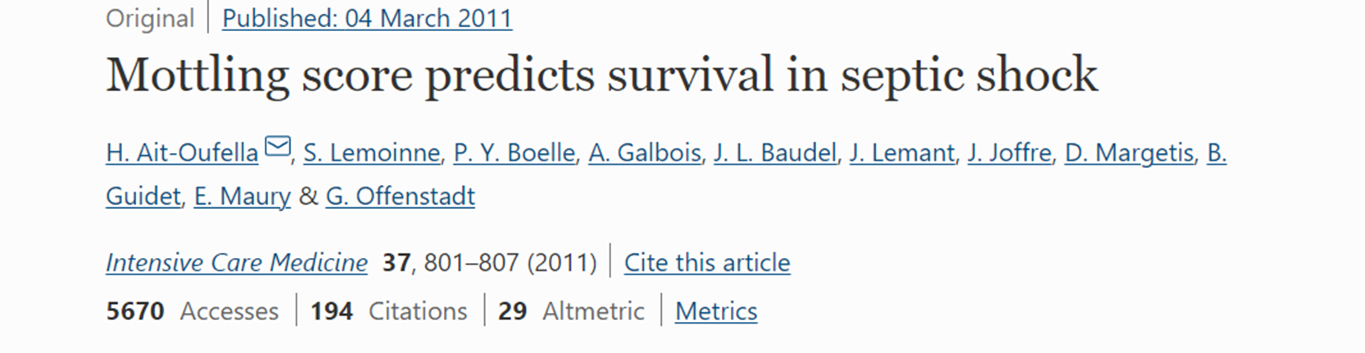
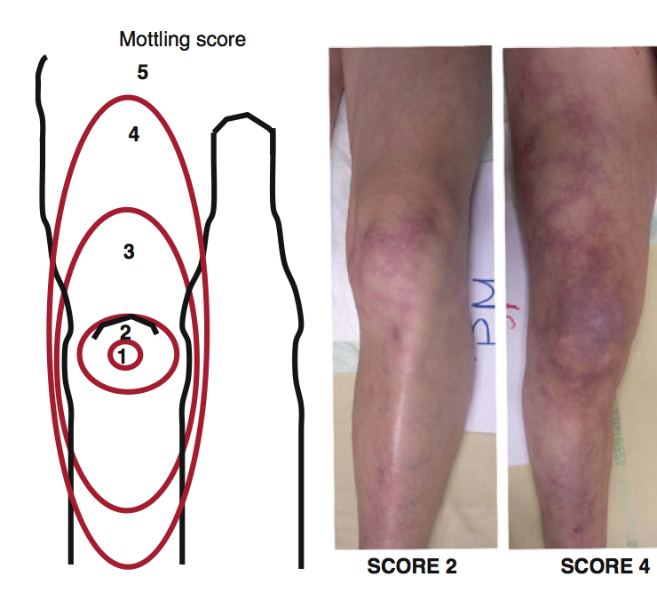

Slide 8
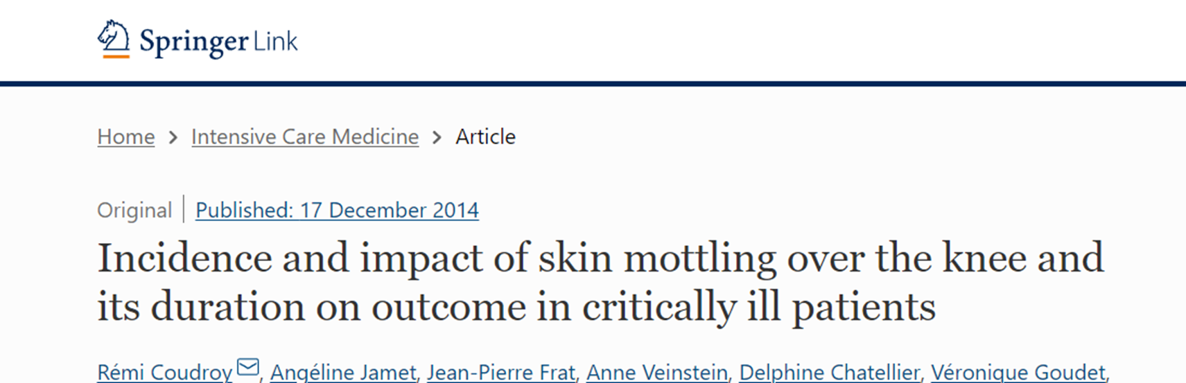
Result
Incidence of skin mottling was 29 % (230 of 791 patients)

Slide 9
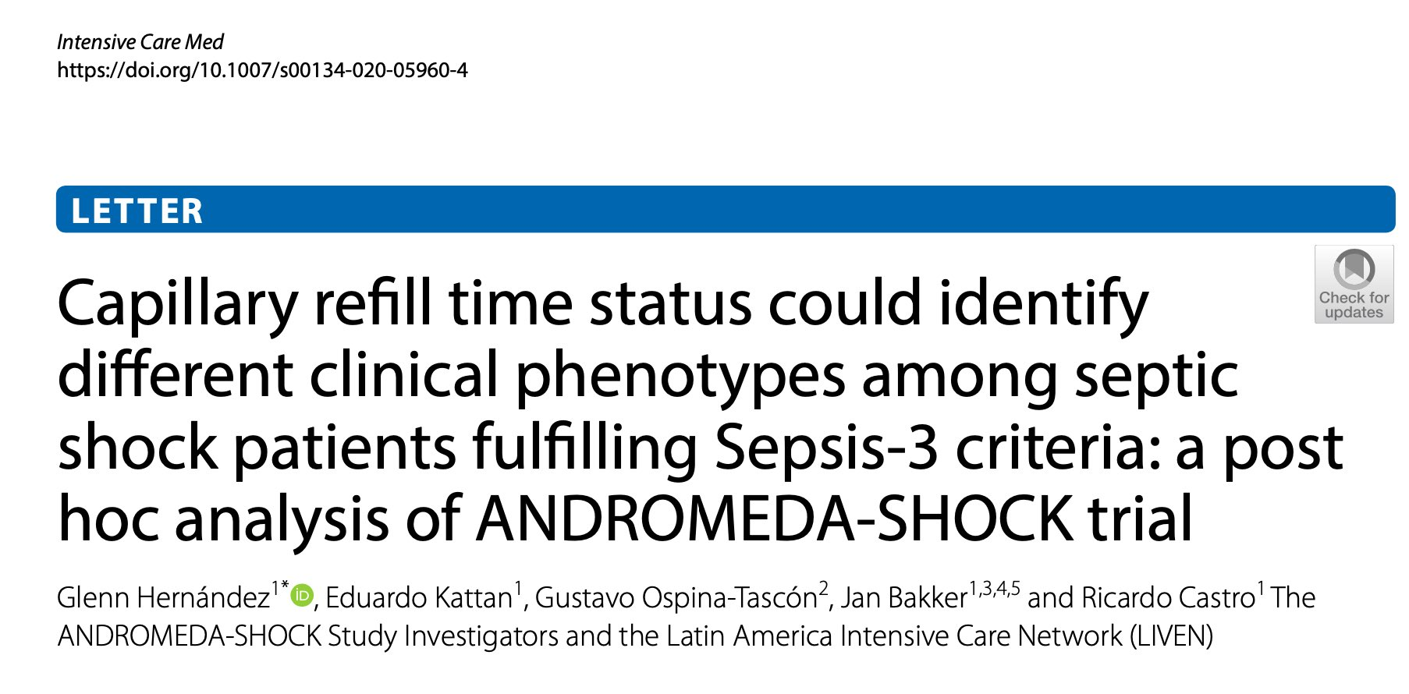
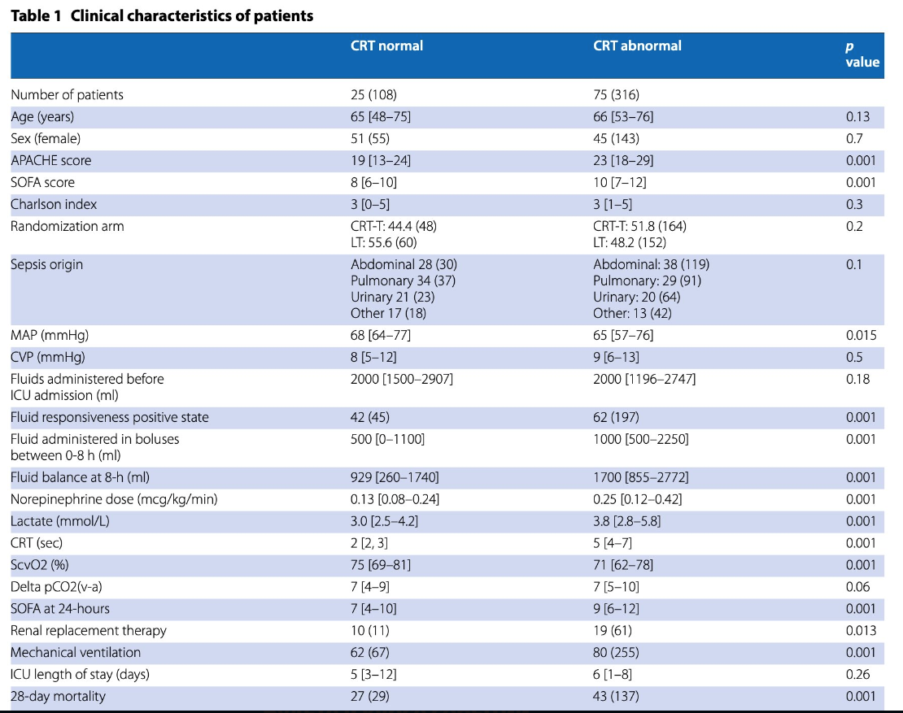
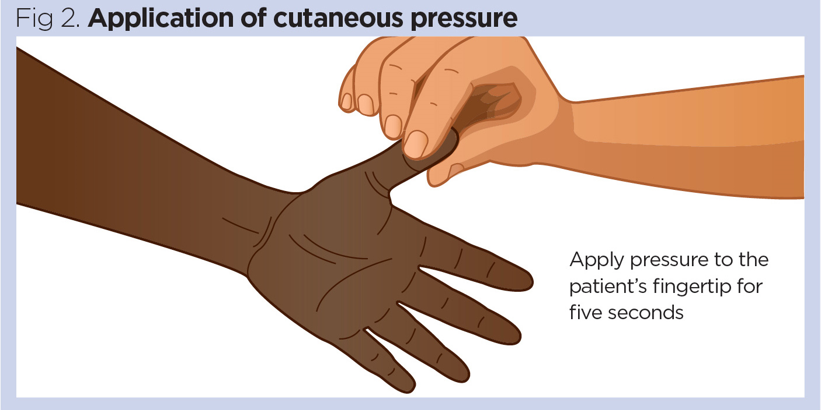

Slide 10
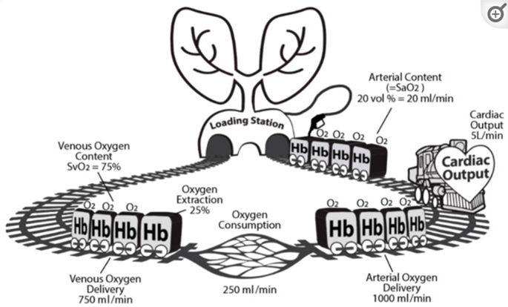
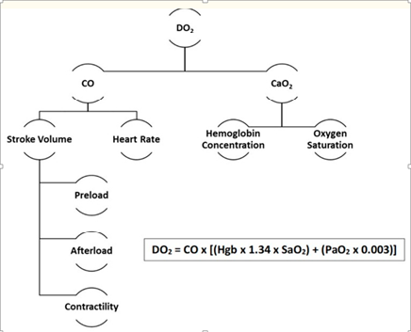
Determinants of Oxygen Delivery (DO2)
Cardiac output
Oxygen content

Slide 11
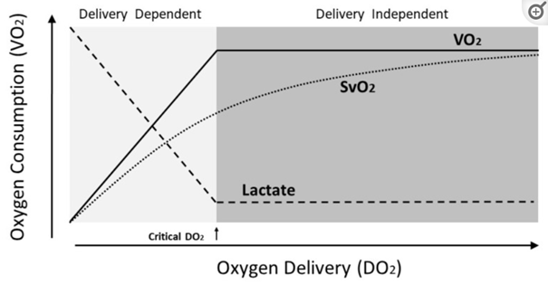

Slide 12
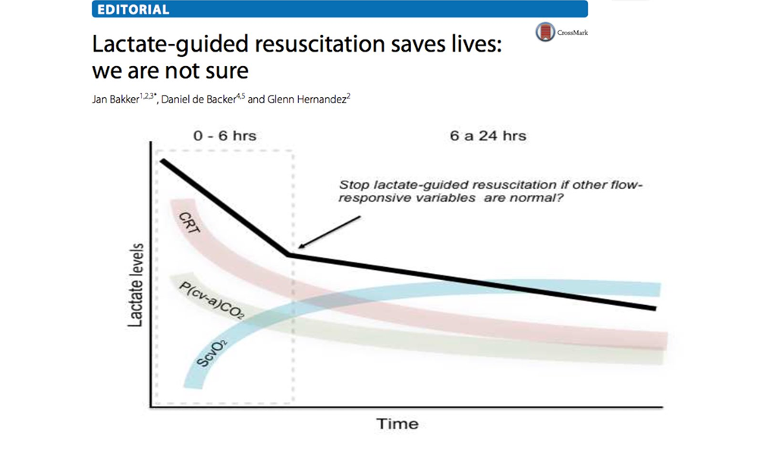


Slide 13
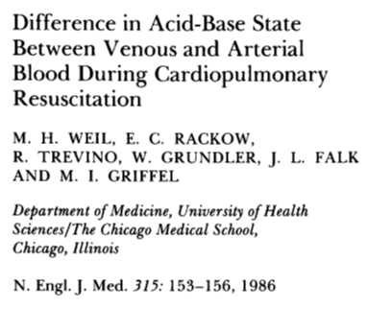
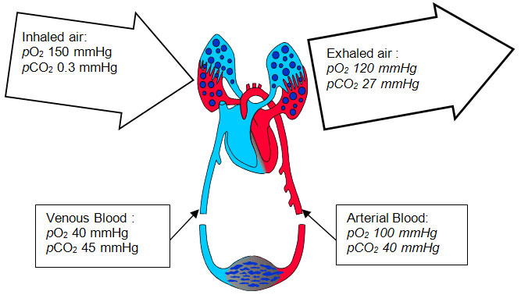
CO2-gap
High pCO2-gap is an alarming signal of inadequate CO/stagnation

Slide 14
Arterial
Venous
pH: 7.377
PCO2: 44.0 mmHg
PO2: 130.1 mmHg
BE: +0.2 mmol/L
HCO3-: 25.3 mmol/L
HCO3 st: 24.0 mmol/L
SO2: 98.8%
Glu: 11.1 mmol/L
Na: 141.8 mmol/L
K: 4.47 mmol/L
Lac: 2.4 mmol/L
Ca: 1.311 mmol/L
Cl: 103.3 mmol/L
pH: 7.343
PCO2: 57.4 mmHg
PO2: 25.0 mmHg
BE: +2.9 mmol/L
HCO3-: 30.5 mmol/L
HCO3 st: 26.2 mmol/L
SO2: 49.3 %
Glu: 9.5 mmol/L
Na: 146.0 mmol/L
K: 4.43 mmol/L
Lac: 2.2 mmol/L
Ca: 1.106 mmol/L
Cl: 98.9 mmol/L
dCO2=13 mmHg
ScvO2= 49 %

Slide 15
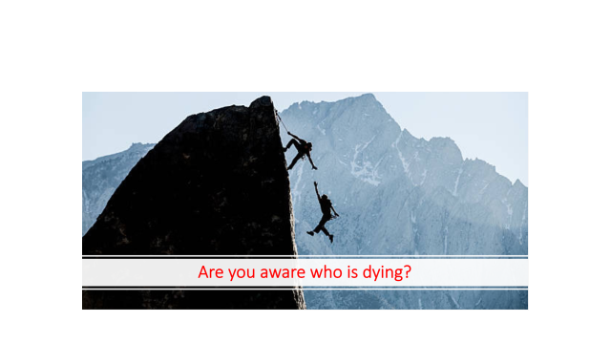

Slide 16
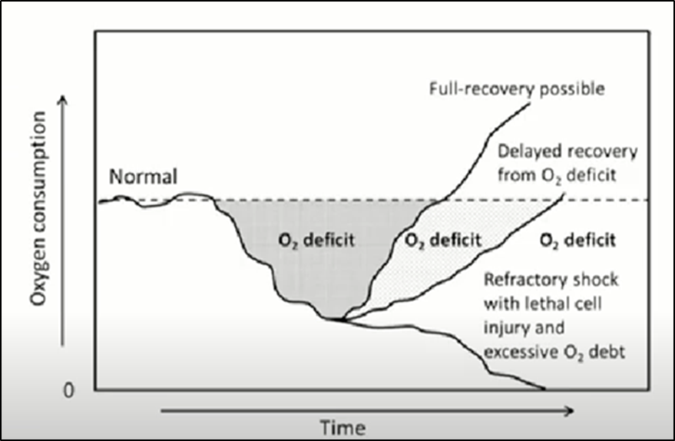


Slide 17
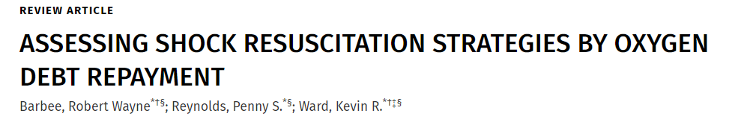
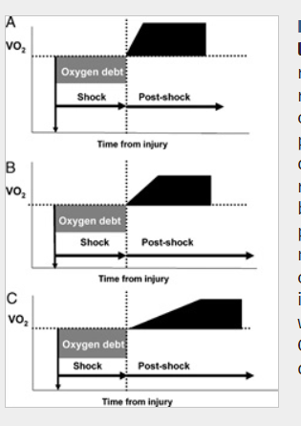
Organ function
120 of SBV
30 of SBV
DİAGNOSİS CAN WAİT BUT CELLS CAN’T!
15 of SBV

Slide 18
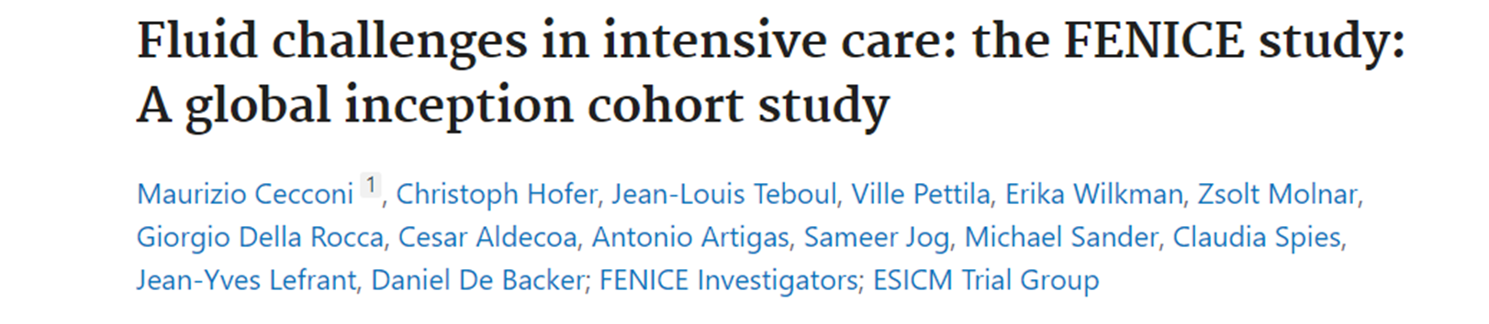
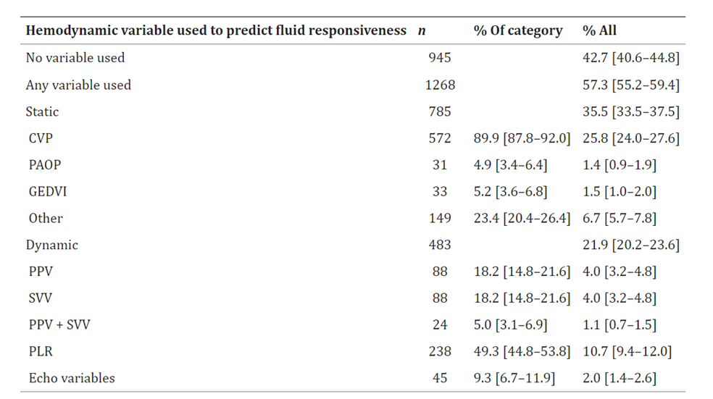
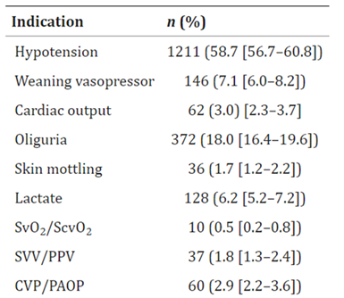

Slide 19
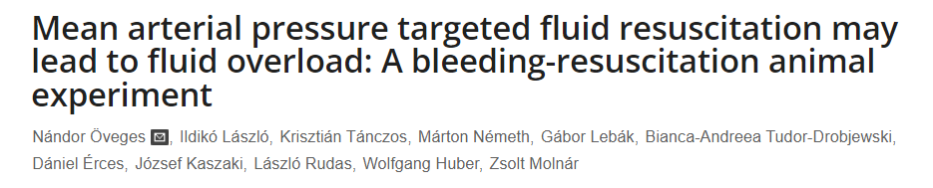
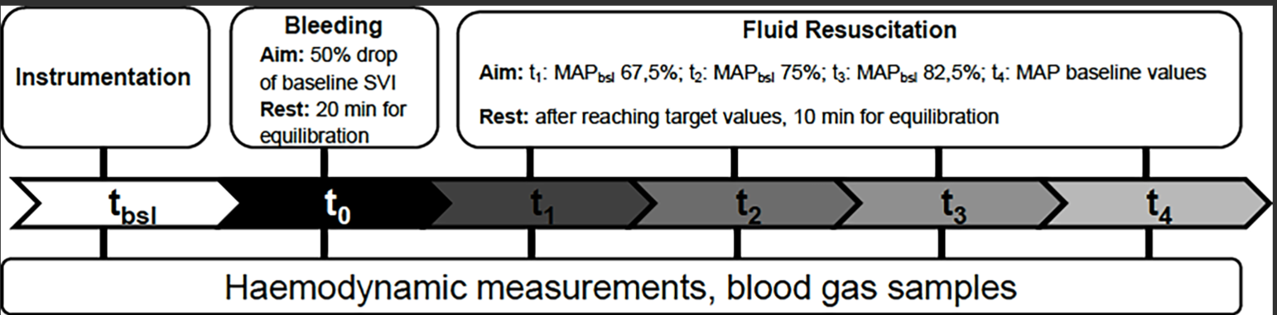
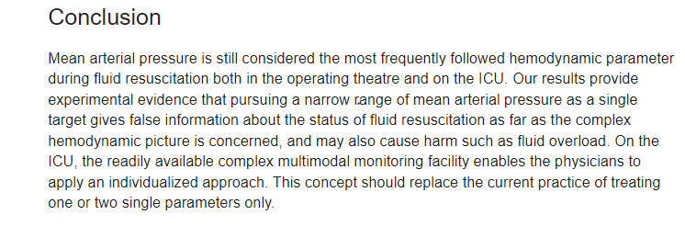

Slide 20
PRELOAD DƏYƏRLƏNDİRİLMESİ
Inferior Vena Cava (IVC) Collapsibility
Passive Leg Raise (PLR)
IVC diameter ≤2.1 cm
and
50% collapsible
CVP 0-5 mmHg
IVC diameter>2.1 cm
and
<50% collapsible
CVP 10-20 mmHg

Slide 21
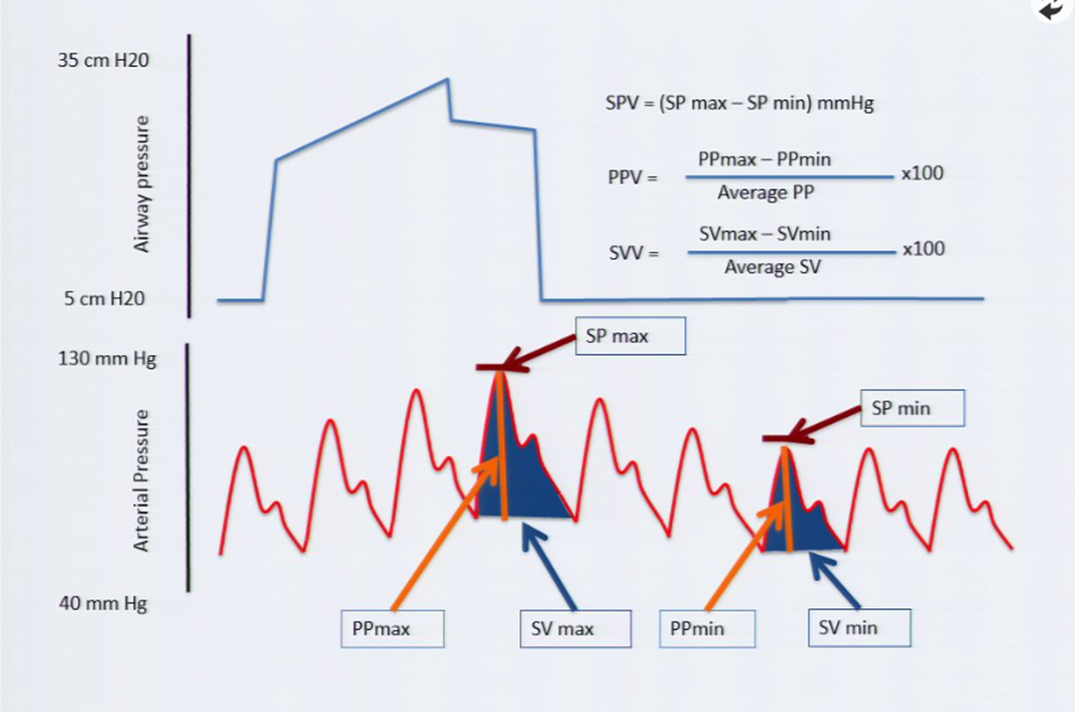
PRELOAD DƏYƏRLƏNDİRİLMƏSİ
STATİK
DİNAMİK
TƏZYİQ
VOLUM
PPV
SPV
SVV
IVK/SVK
CVP
PAWP
GEDV
LVEDV
EVLW

Slide 22
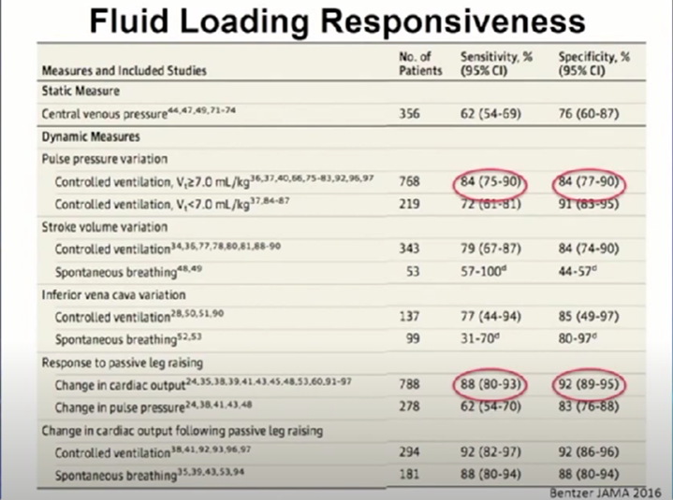

Slide 23
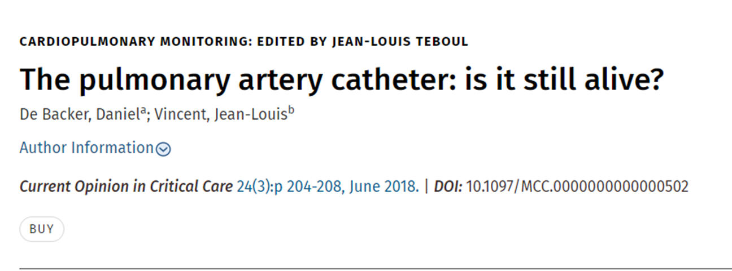
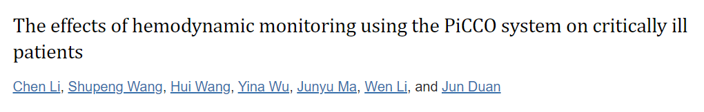
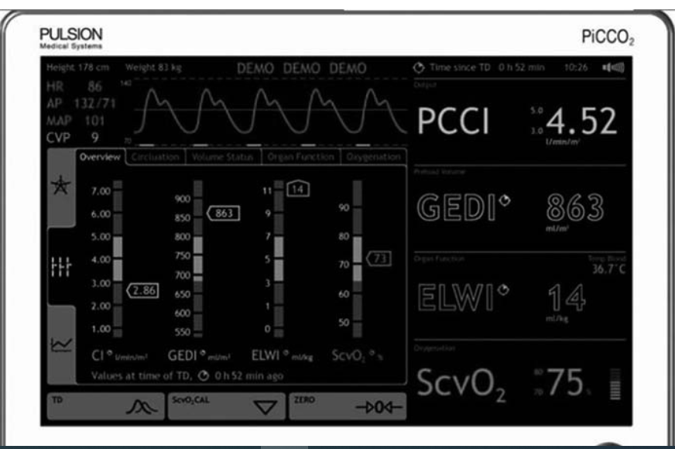

Slide 24
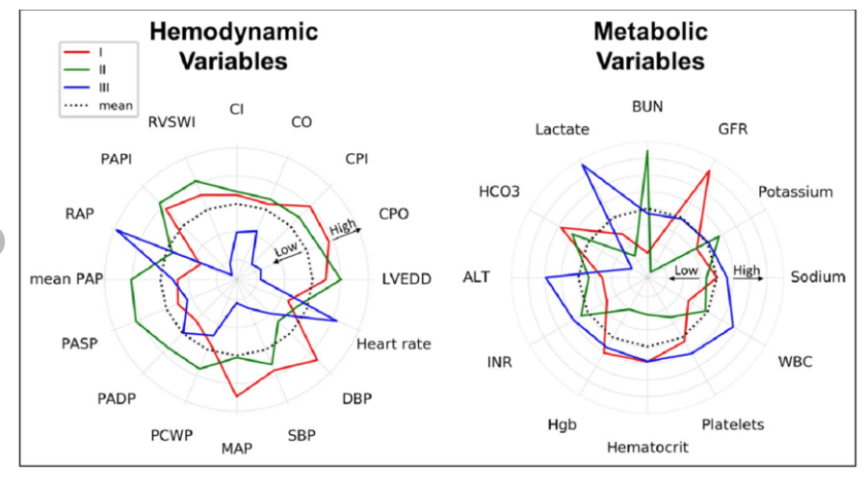
.
Radar plots illustrate the association of each phenotype with hemodynamic and metabolic variables in CSWG( Cargiogenic Shock Working Group Registry) myocardial infarction cohort

Slide 25
OXYGENATION
SEDATION
METABOLİC
OPTİMİZATİON
MECHANICAL VENTILATION
COOLING
SPESIFIC TREATMENT OF HYPERMETABOLISM
TRANSFUSION

Slide 26
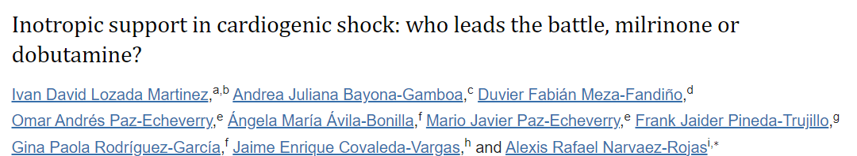
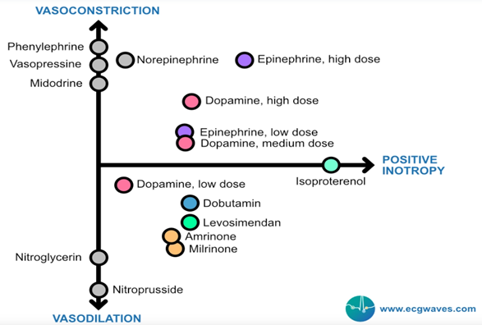

Slide 27
CARDIAC POWER OUTPUT (CPO)
CPO = MAP X CO/451
PULMONARY ARTERY PULSATILITY INDEX (PAPI)
PAPI = sPA – dPA / RA
CPO < 0.6
Calculate PAPI
PAPI < 0.9, RA>12, DSA*
PAPI > 0.9
Possible RV Failure
RV Normal
Consider RV Support
Consider LV Support

Slide 28
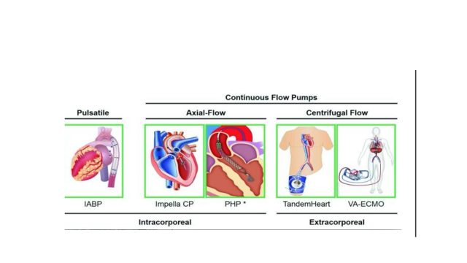
MEXANİKİ DƏSTƏK CİHAZLARI

Slide 29

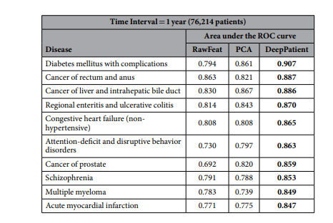
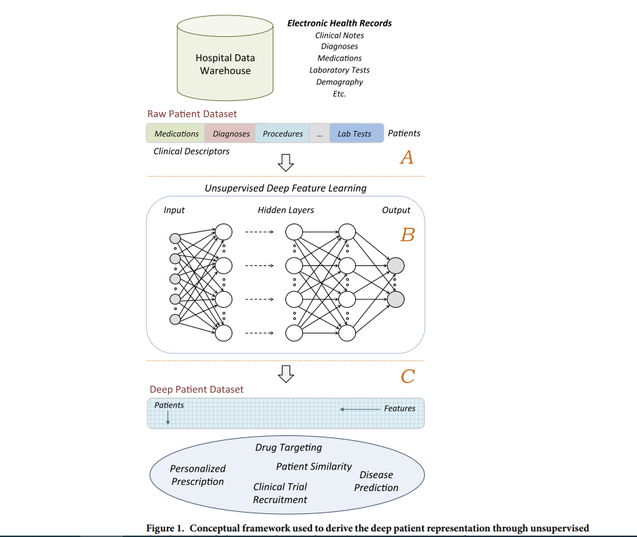
704.854
Xəstə

Slide 30
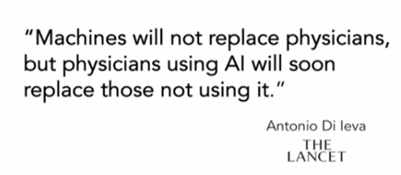
Well, I think it’s going to change what we do, but the good news is, at least you’re not a pathologist
My wife is just graduating and she’s a pathologist
Put away as much money as you can really fast

Slide 31
A Modest Proposal
Make the patient the center
PERSONALIZED MEDICINE
TƏŞƏKKÜRLƏR...

